Slide 1
Library Management

Slide 2
Introduction
C# web application developed to manage check-in/check-out in a library
Options to add a new member, check-in/check-out
Validations added.

Slide 3
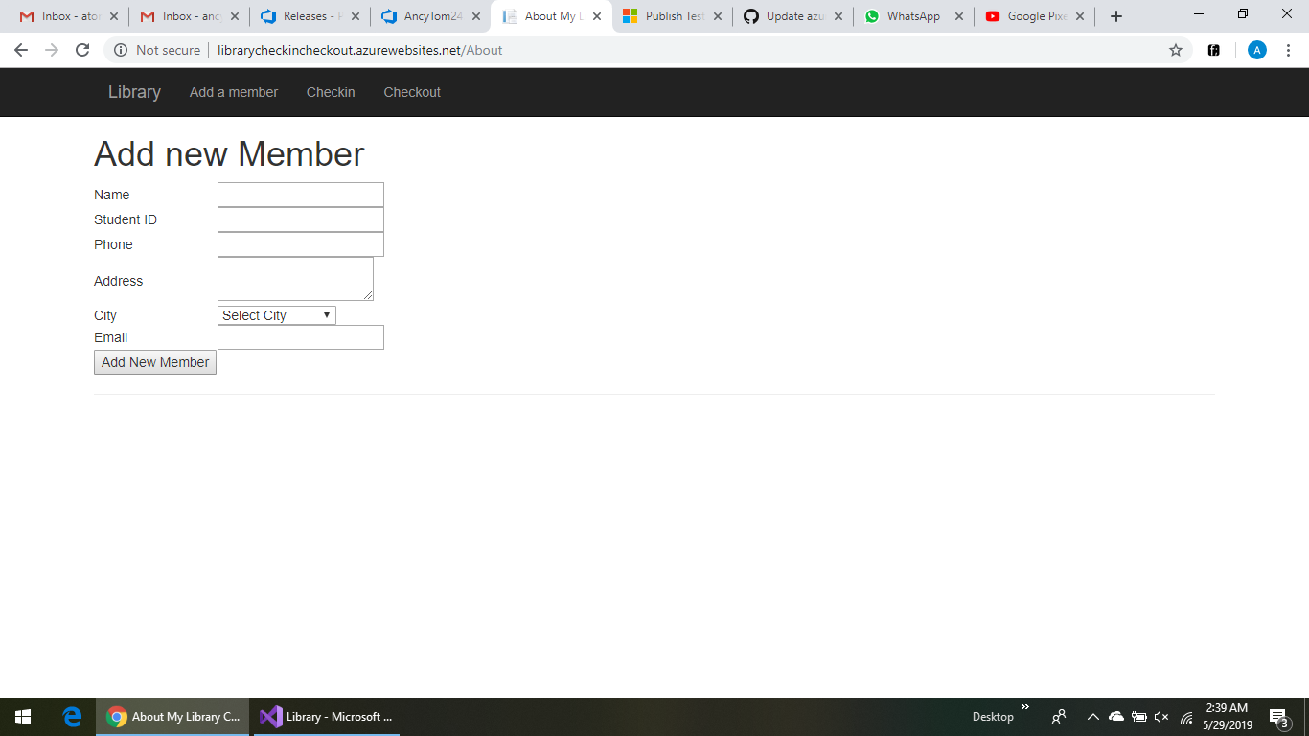

Slide 4
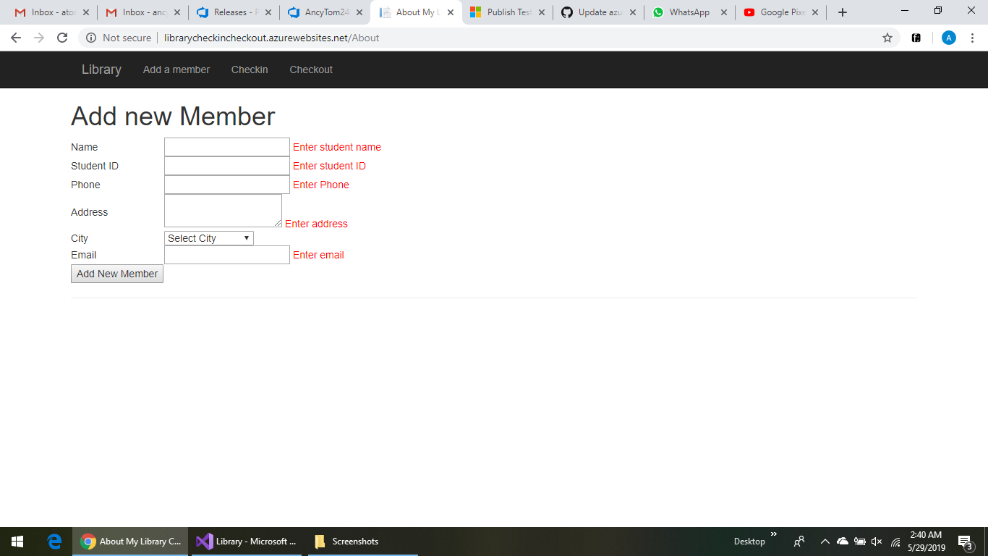

Slide 5
GitHub
Code in vs IDE is integrated to GitHub
GitHub repository : https://github.com/AncyTom24/Library.git
Continuous code integration through Git.
Push all code to the repo regularly

Slide 6
Azure DevOps
We create build and release pipeline from azure DevOps.
We do the configuration setups and build the pipeline, create artifact and deploy the release pipeline

Slide 7
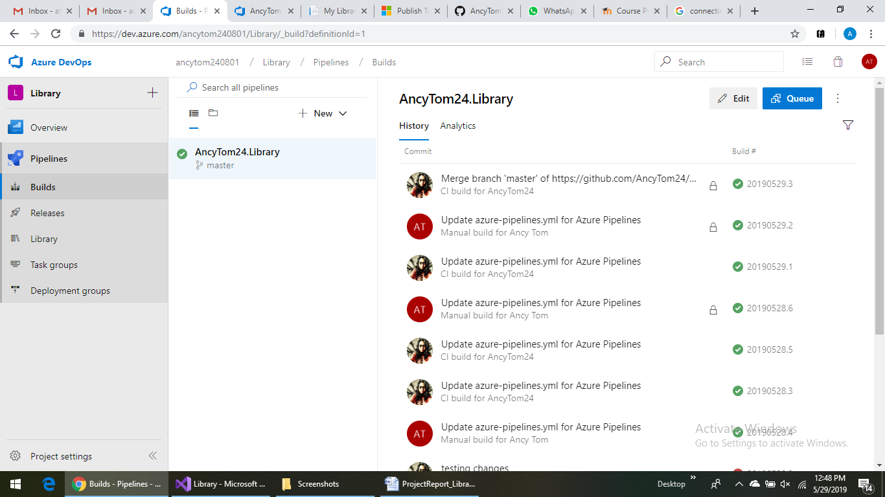

Slide 8
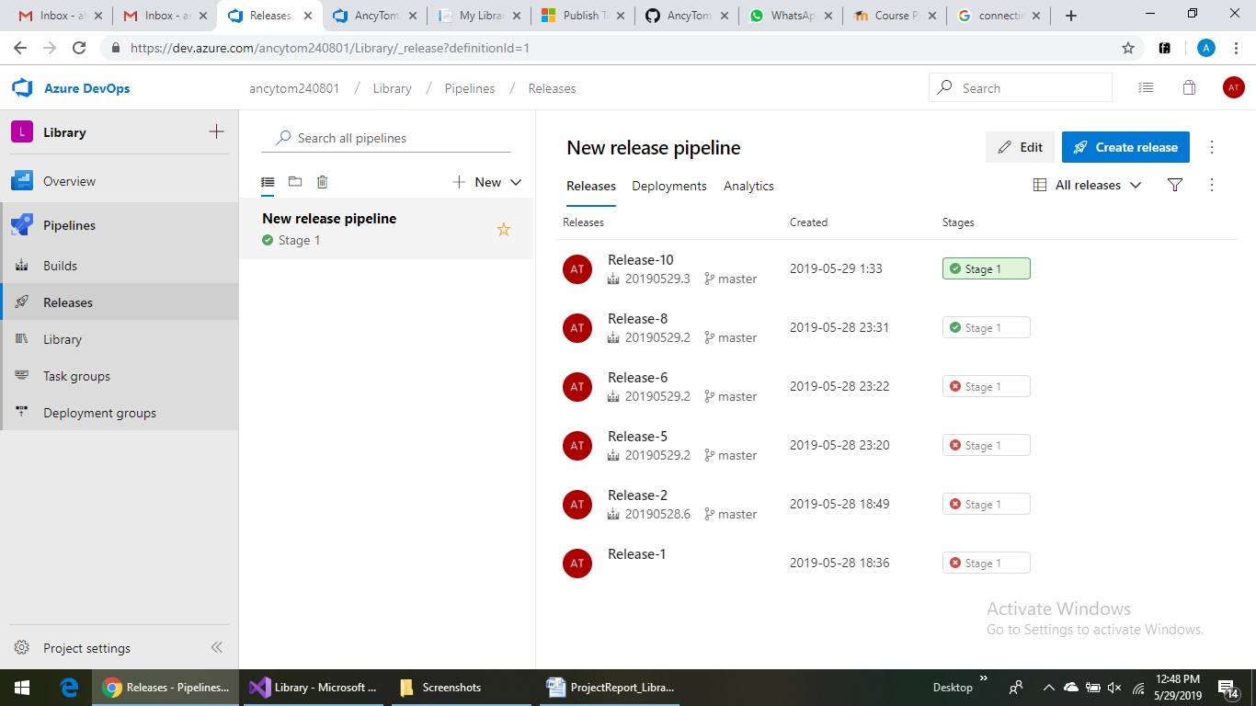

Slide 9
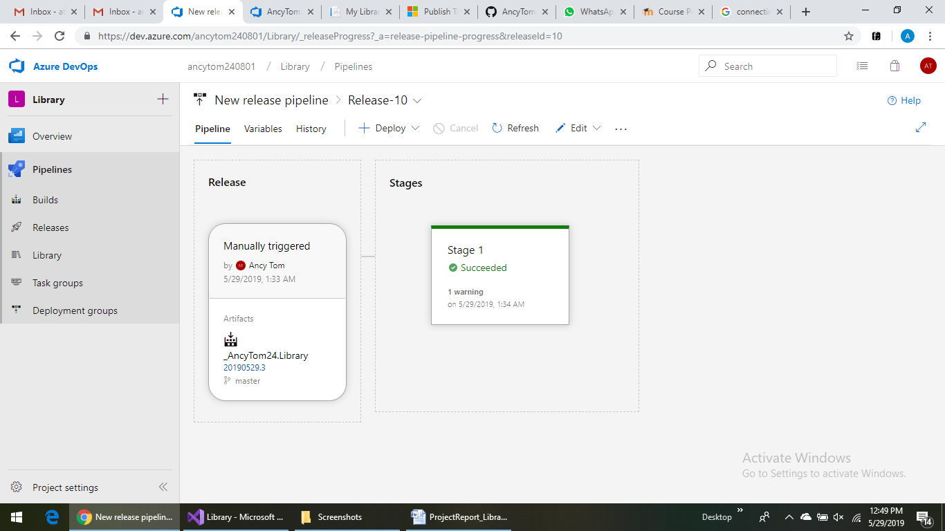

Slide 10
Testing
Unit testing is done from vs unit test for .NET framework project.
This check the form validation testing and the button functionalities.

Slide 11
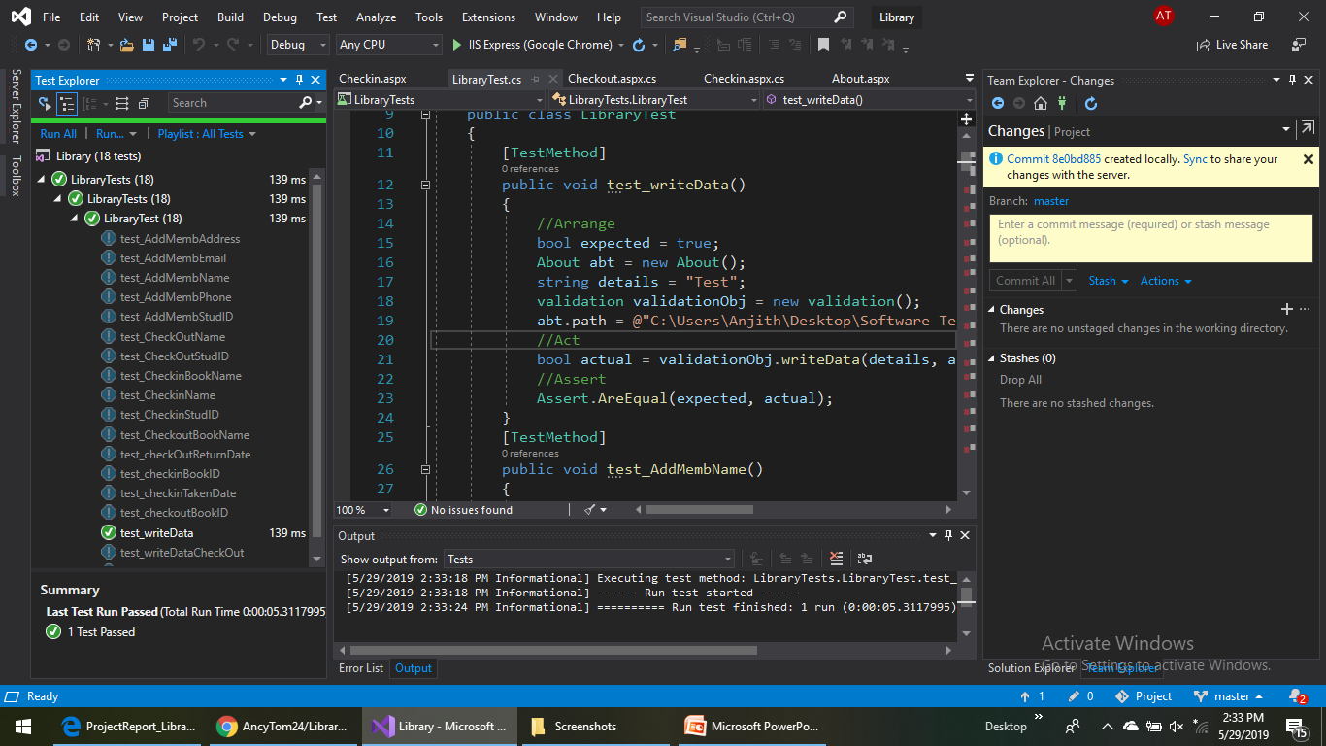

Slide 12
Thank you

